Slide 1
Next Few Labs
06 Oct: Lab 9 – Earthquakes
(Patrick Duff)
13 Oct: Lab 7 – Measuring Geologic Time
(Patrick Duff)
Oct 20: No Lab (Fall Break, 22-23 Oct)
Oct 27: Lab 8 – Fossils & Evolution
Granite
Gneiss

Slide 2
LAB 5: Metamorphic Rocks & Tectonic Settings
Part 1: Metamorphic Rock Identification
Metamorphic Rock Chart
Part 2: Putting It All Together
Tectonic Settings Questionnaire

Slide 3
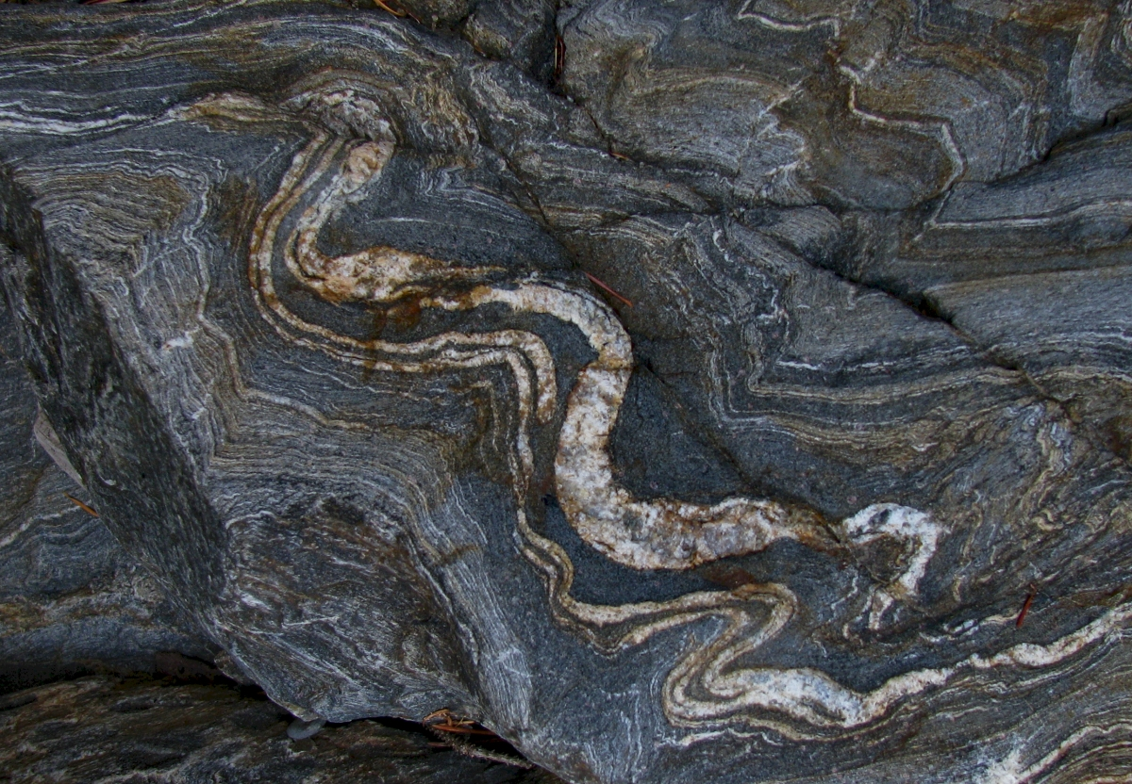
PART 1: Metamorphic Rock Id
Granite
Gneiss

Slide 4

What are Metamorphic Rocks?

Slide 5
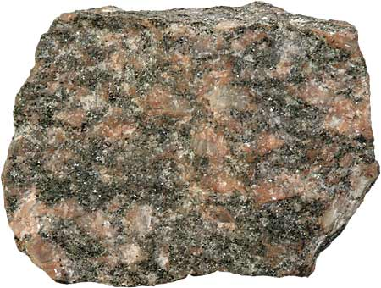
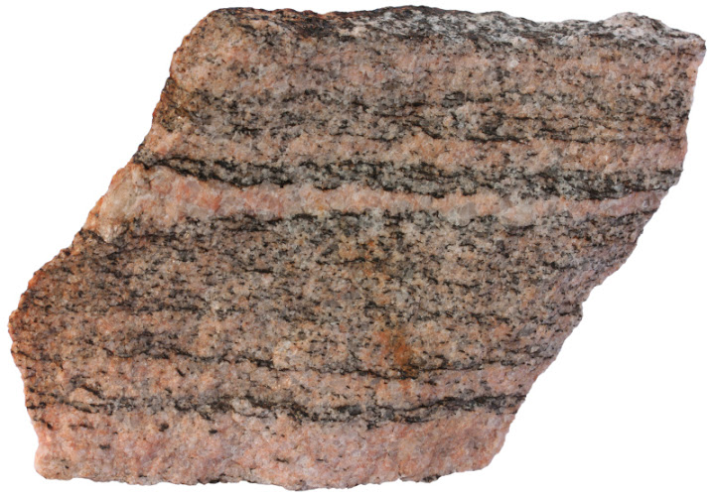
Metamorphic Rocks
Rocks altered physically and /or chemically by:
Pressure
Temperature
Chemical action of hot fluids
Protolith = parent rock
Granite
Gneiss

Slide 6
The Concept of Geothermal Gradient
Temperature increases with depth at a rate of
20-30ºC/km in the crust.
Temperature
B
Deeper in Crust
A

Slide 7
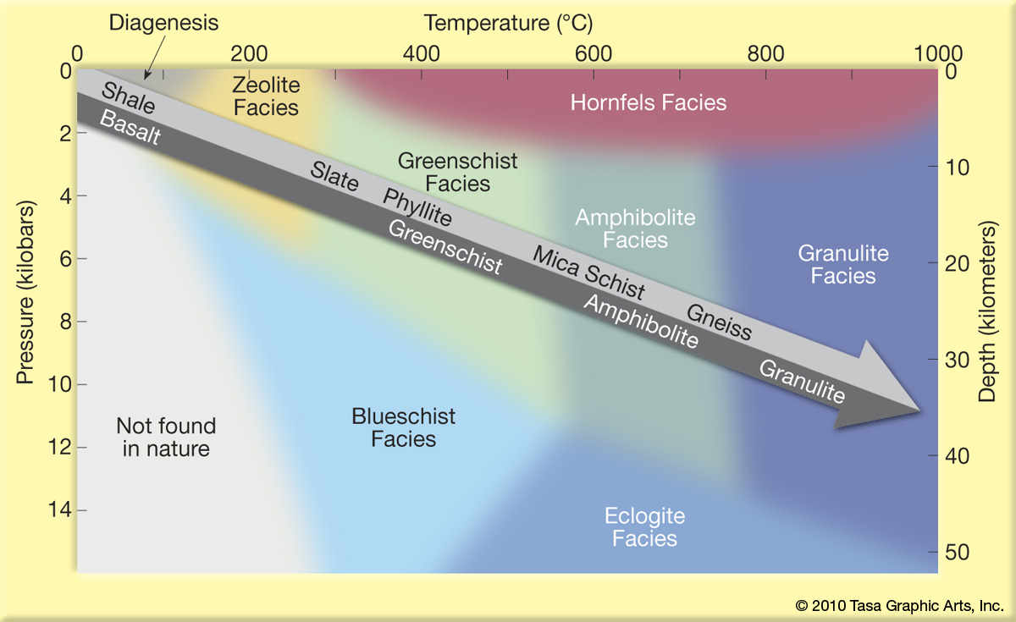
Metamorphic Grade (how much a rock changed)
Low Grade
High Grade

Slide 8
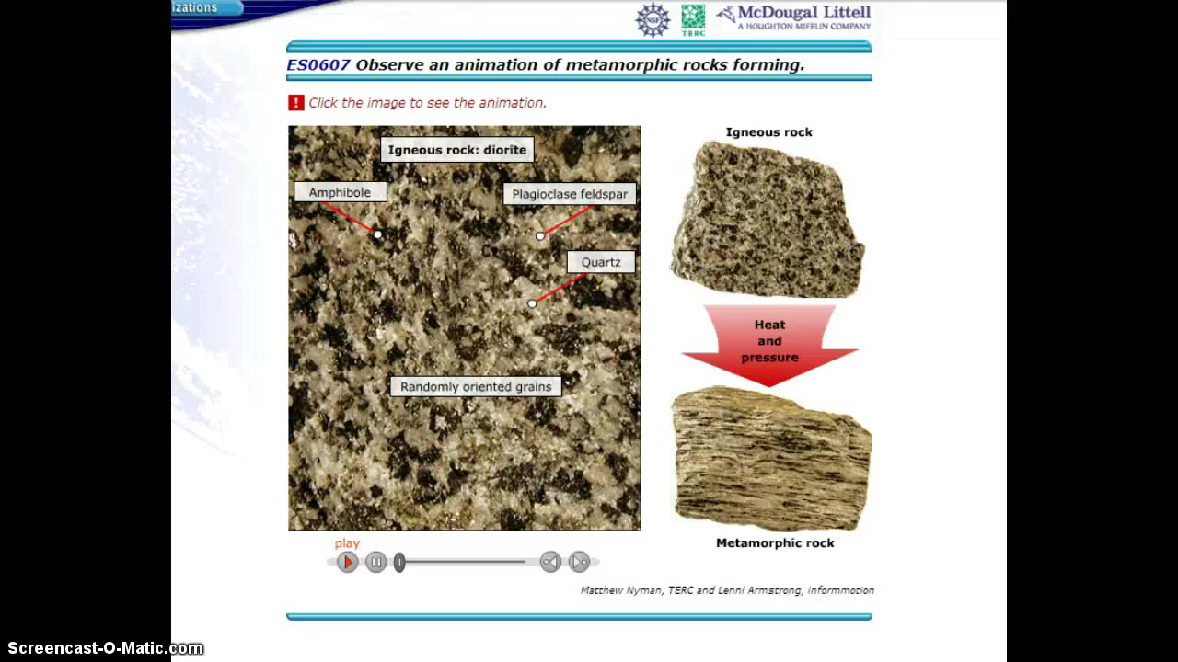
Foliation

Slide 9
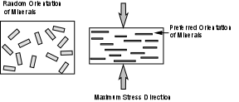
Foliation
Random orientation
of minerals
Preferred orientation
of minerals
Max Stress direction

Slide 10
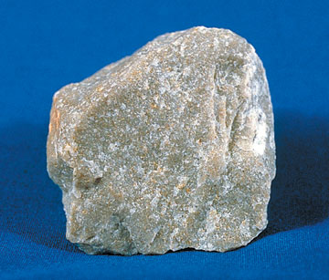
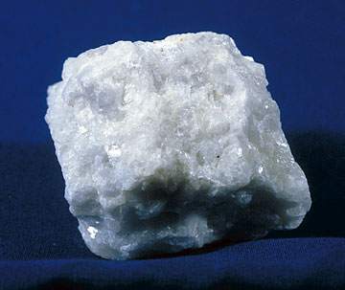
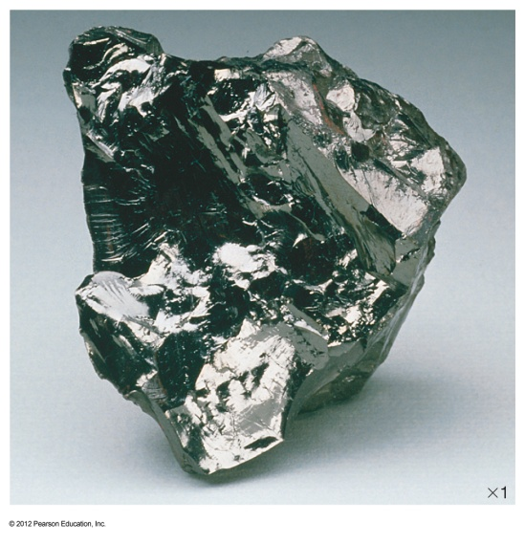
Non-Foliated
Do not have layering of minerals
They are characterized by granular texture

Slide 11
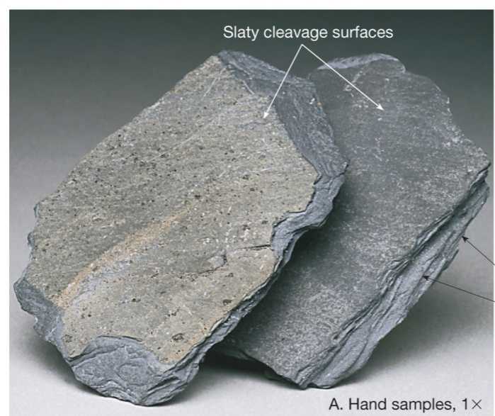
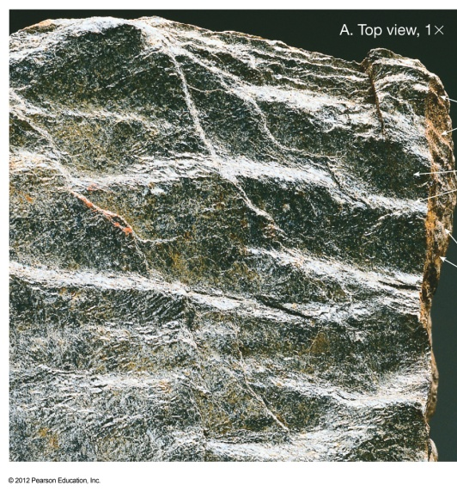
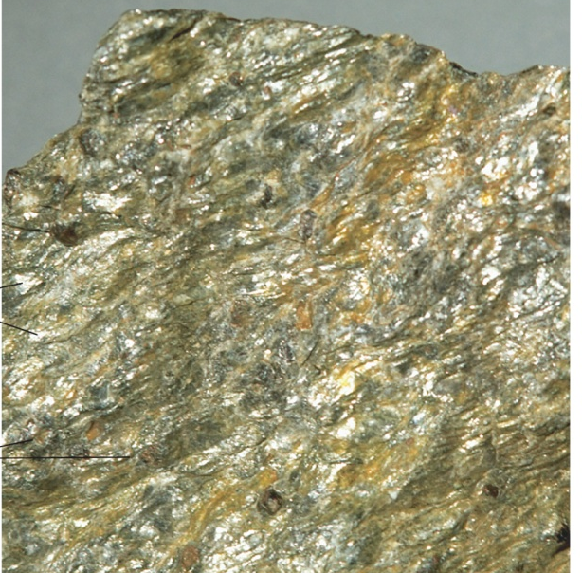
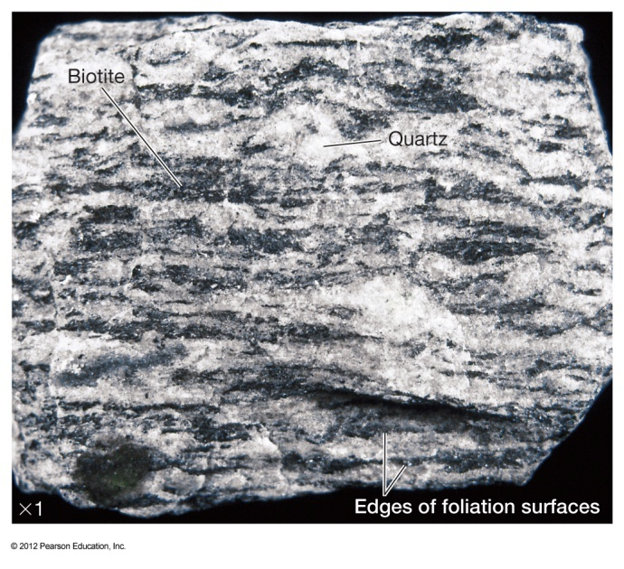
Slaty cleavage: Nearly perfect planar
Phyllitic texture: Wavy fine-grained foliation
Schistosity: Scaly glittery layering of platy minerals
Gneissic texture: layers of alternating light and dark minerals

Slide 12
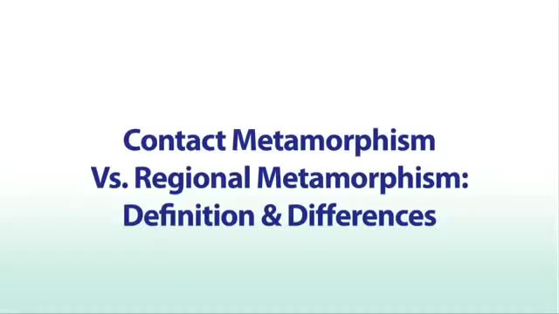
Contact & Regional Metamorphism

Slide 13
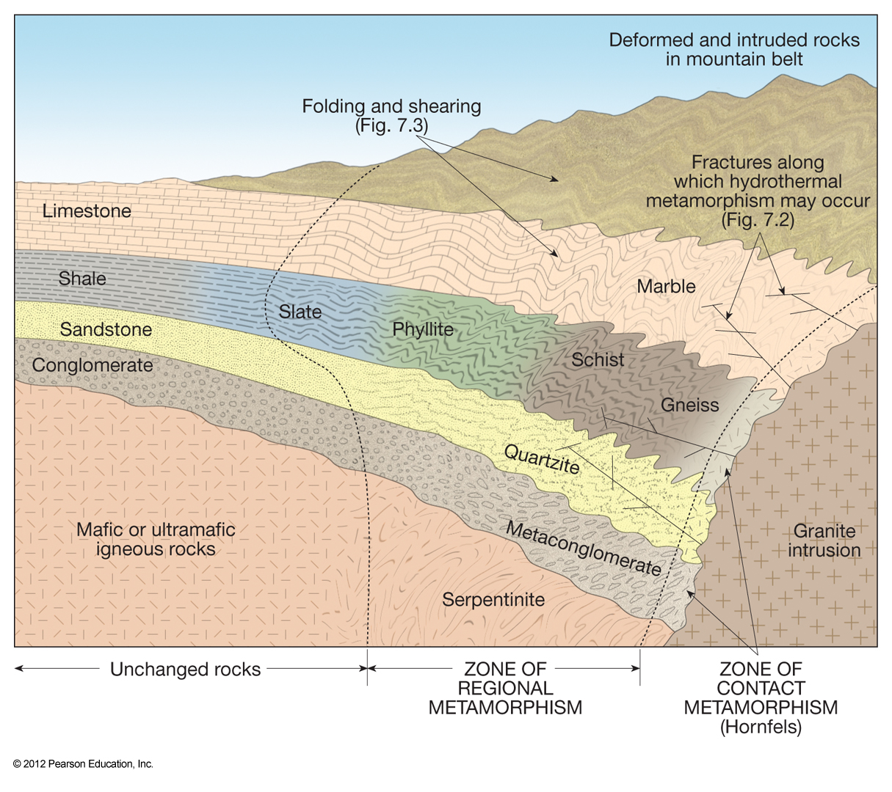

Slide 14
PART 2: Putting It All Together
Mid-Atlantic Ridge
Top, Middle, Bottom
The Appalachians
Top, Middle, Bottom
The Andes
Top, Middle, Bottom
Granite
Gneiss

Slide 15
PART 2: Putting It All Together
Characterize the 4 rock types
Intrusive igneous rocks
Extrusive igneous rocks
Sedimentary rocks
Metamorphic rocks
15 minute rotations
Identify each rock
Describe the rocks’ relationship to the tectonic setting
Granite
Gneiss

Slide 16
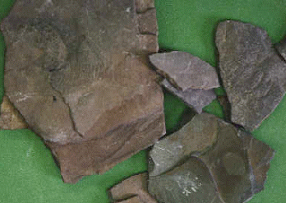
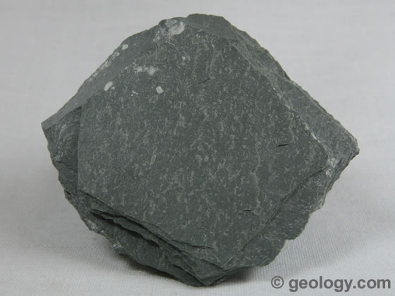
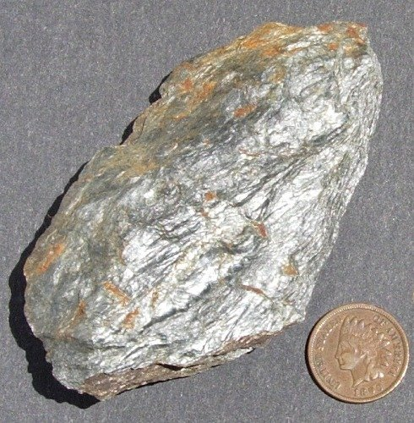
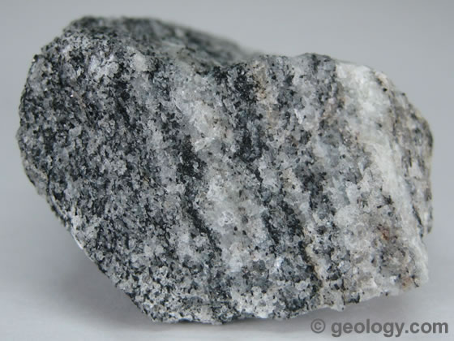
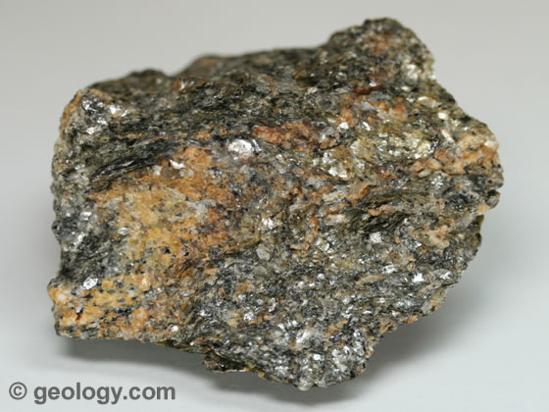
Shale
protolith
Slate
Phyllite
Gneiss
Schist
Foliated
Non-Foliated
Coal
Quartzite
Marble

